Slide 1

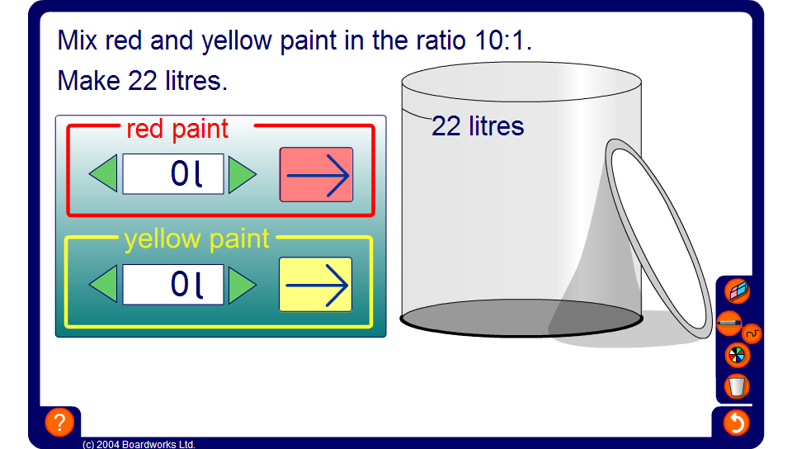


Mixing paint
Notes:
Use this activity to introduce the problem of dividing an amount in a given ratio.
Pupils could start by trying to fill the pot by trial and error.
Remind pupils what the ratio means. For example, ‘mix red paint and yellow paint in the ratio 4:1’ means that for every 4 litres of red paint, there is 1 litre of yellow.
Demonstrate that the pot can be filled part by part. For example, if we are asked to mix 10 litres of red and yellow paint in the ratio 4:1, start by adding 4 litres of red and 1 litre of yellow to the pot. Tell pupils that this gives us the correct shade but that we need 10 litres altogether. Press the arrows to add another 4 litres of red and another litre of yellow.
Ask pupils to note down the total amount of each colour required to fill the pot in a given ratio. Work towards the more efficient method of adding the total number of parts in the ratio together and dividing this into the total number of litres required. Explain that this gives us the number of litres in each part. Multiplying this by each part of the ratio gives us the exact amount of each colour required.

